Slide 1






@ChrastinaOndrej
@Simply007 (BrmoSample)
@Simply007
Progressive Web Apps
ondrejchrastina
https://github.com/Simply007/BrmoSample
Notes:
https://developers.google.com/web/updates/2015/12/getting-started-pwa

Slide 2
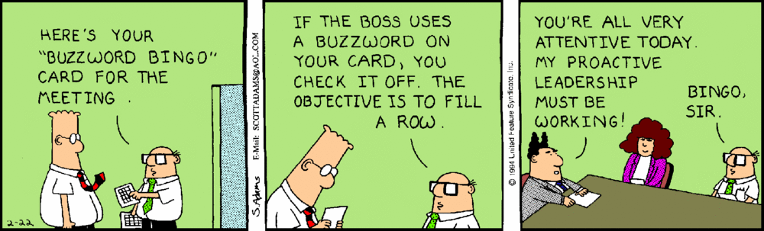

Progressive Web Apps
Reliable
Fast
Engaging
Progressive
Responsive
Connectivity independent
App-like
Fresh
Safe
Dicoverable
Re-engageble
Installable
Linkable
Notes:
https://developers.google.com/web/progressive-web-apps/
https://codelabs.developers.google.com/codelabs/your-first-pwapp/#0

Slide 3
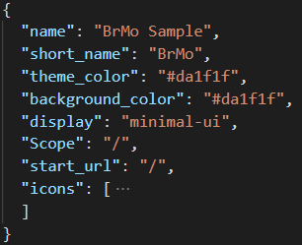
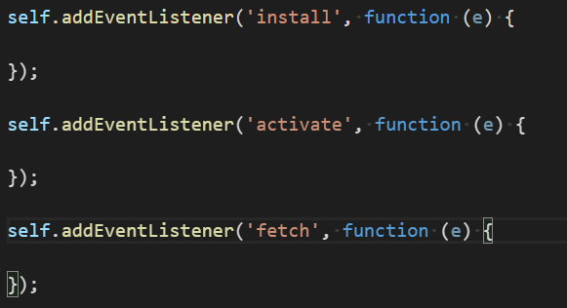
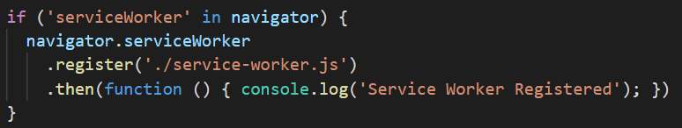
Progressive Web Apps
Web Manifest
Service worker + Cache API
manifest.json
service-worker.js
Notes:
https://www.w3.org/TR/appmanifest/
https://www.w3.org/TR/2017/WD-service-workers-1-20171102/#serviceworker-interface

Slide 4

Demo time
Notes:
https://developers.google.com/web/tools/workbox/
https://developers.google.com/web/fundamentals/instant-and-offline/offline-cookbook/
https://codelabs.developers.google.com/codelabs/your-first-pwapp

Slide 5

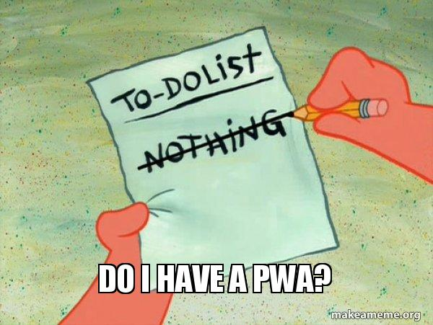

Lighthouse
Notes:
https://developers.google.com/web/tools/lighthouse/
https://webhint.io/

Slide 6
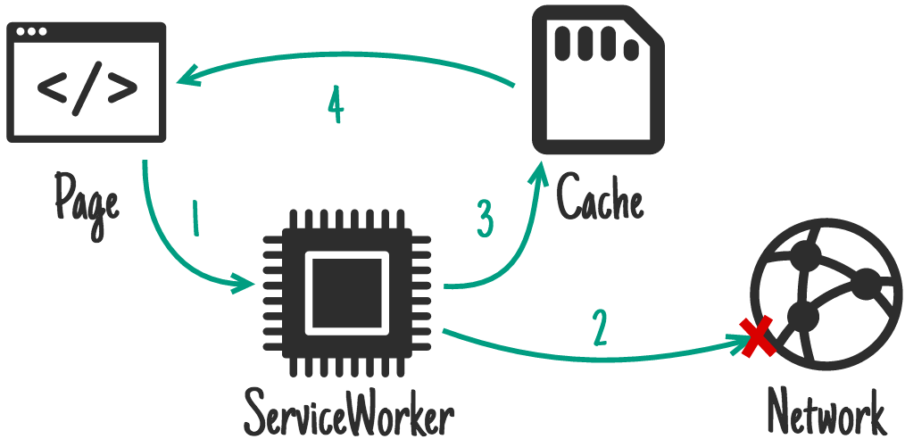
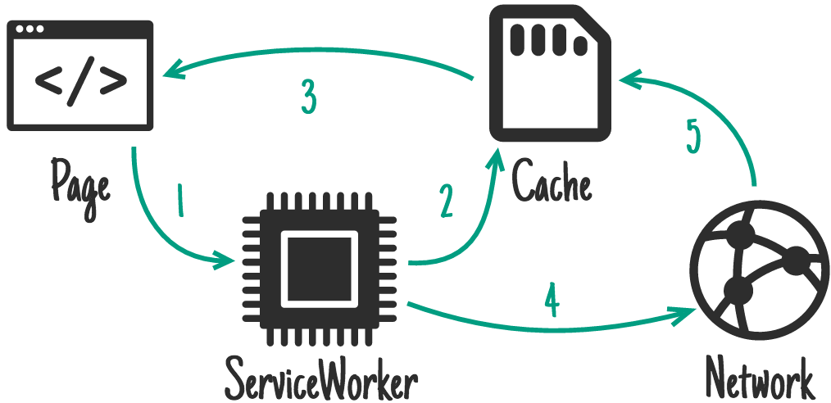

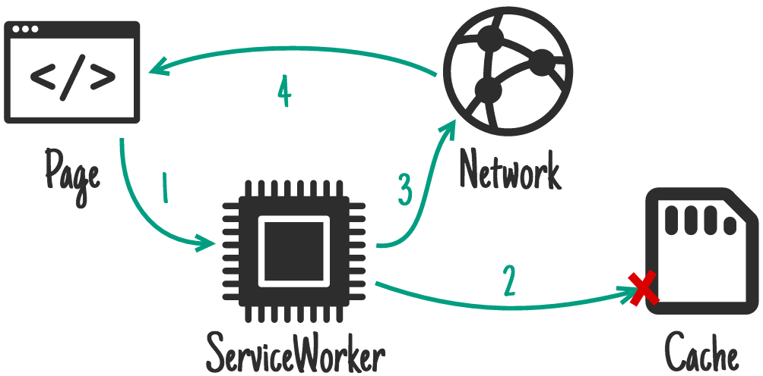
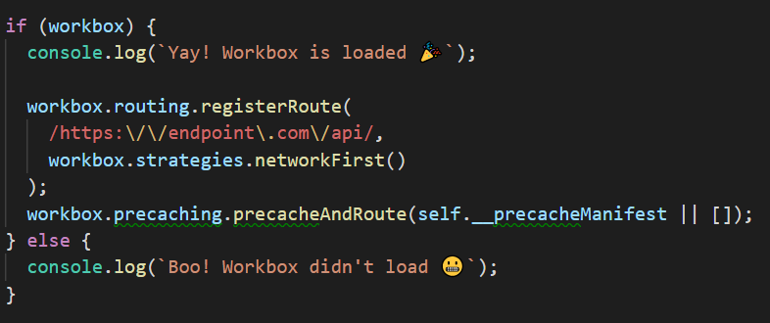
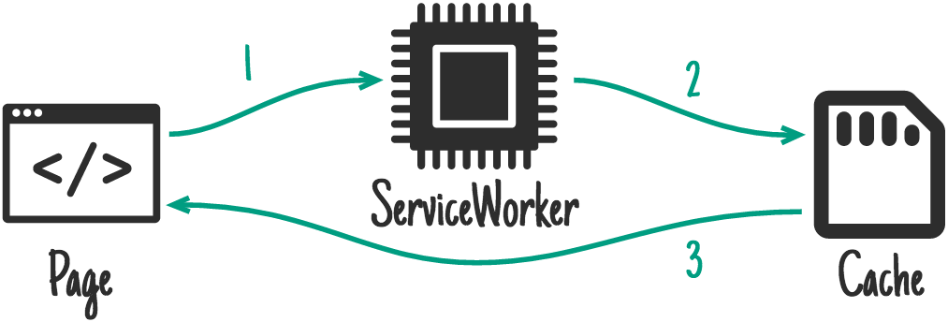
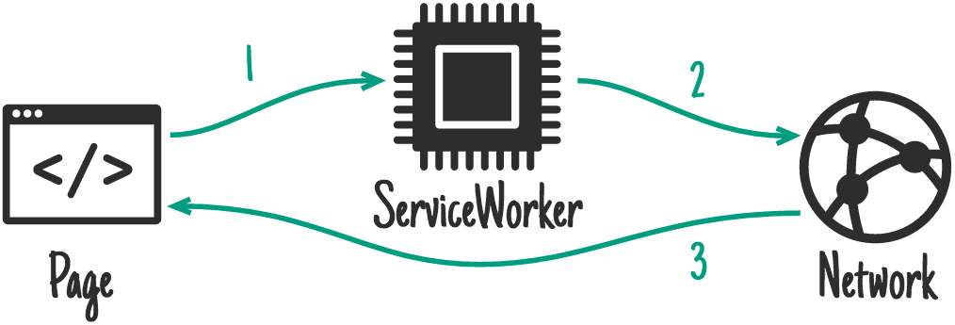



Notes:
https://developers.google.com/web/tools/workbox/
https://developers.google.com/web/fundamentals/instant-and-offline/offline-cookbook

Slide 7




Google Progressive Web Apps
@bryan_soltis
w3.org
@ChrastinaOndrej
@Simply007
caniuse.com
@Simply007
ondrejchrastina
https://github.com/Simply007/BrmoSample
Notes:
https://developers.google.com/web/progressive-web-apps/
https://medium.com/@bryan_soltis
https://medium.com/@Simply007
https://www.w3.org/TR/appmanifest/
https://www.w3.org/TR/2017/WD-service-workers-1-20171102/#serviceworker-interface
https://caniuse.com
https://www.pwabuilder.com

